Slide 1




OpenMRS-OMOP ETL tool for LMICs
Juan Espinoza, MD*^{1,2}, Abu (Sab) Sikder, BA*², Armine Lulejian, EdD³, Barry Levine, PhD⁴
¹ Department of Pediatrics, Children’s Hospital Los Angeles, Los Angeles, CA
² Innovation Studio, Children’s Hospital Los Angeles, Los Angeles, CA
³ Department of Population and Public Health Sciences, Keck School of Medicine,
University of Southern California, Los Angeles, CA
⁴ Computer Science Department, San Francisco State University, San Francisco, CA
*JE and AS are co-first authors
ORCiD

Slide 2


Disclosure
Dr. Espinoza is a paid consultant for AI Health. AI Health had no role in this work.
None of the other authors have any disclosures to report.
Notes:
JA AI health disclosure

Slide 3
Background
Healthcare is becoming more digital in LMICs
EHR adoption has been a major contributor
The rising digitization highlights the need for informatics to build local capacity and strengthen public health systems
LMICs = low and middle income countries
EHR = electronic health record systems

Slide 4

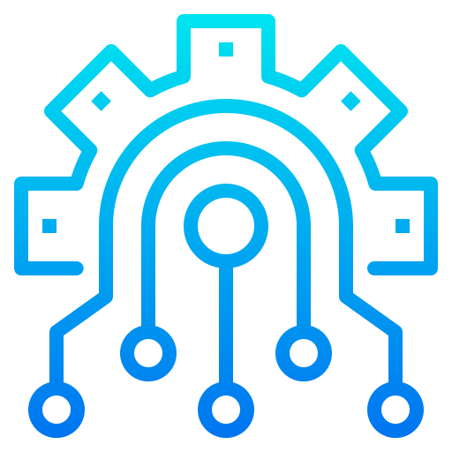


Challenges in LMICs
EHR cost
Interoperability

Slide 5
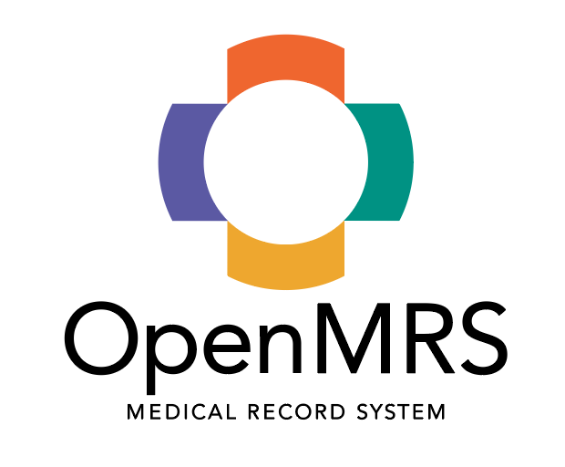

Tech solutions
EHR cost
Open source software have become popular alternatives in LMICs
OpenMRS is an open-source EHR that has been implements in over 60 countries

Slide 6
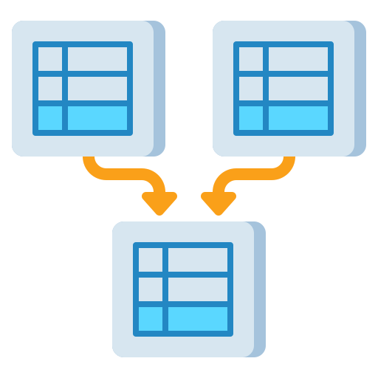
Tech solutions
Interoperability
OMOP CDM
Common data models (CDMs) are an important component of effective collaborative research based on electronic healthcare data.
The Observational Medical Outcomes Partnership (OMOP) common data model (CDM) is one of the most frequently used CDMs in research today.

Slide 7
Objective
OMOP CDM
To develop an open-source OpenMRS-OMOP extract, transform, and load (ETL) pipeline to help facilitate and accelerate collaborative research in and with LMICs that have OpenMRS implementations.
ETL = Extract, transform, and load
Notes:
Remove this

Slide 8
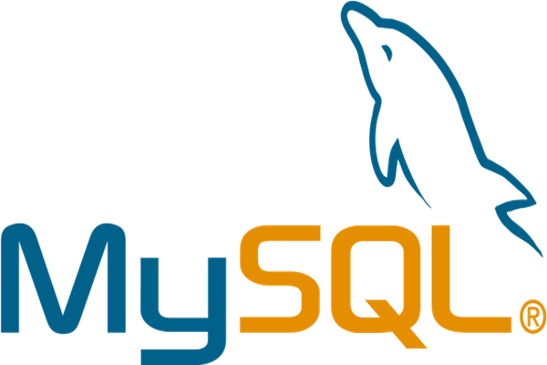


Methods – open source tools
EHR System
Relational database
*MySQL Workbench is the database management software
Data integration platform
Relational database
*pgAdmin is the database management software
Notes:
Add all the technologies. Logo and their name + description e..g Talend = ETL dev

Slide 9
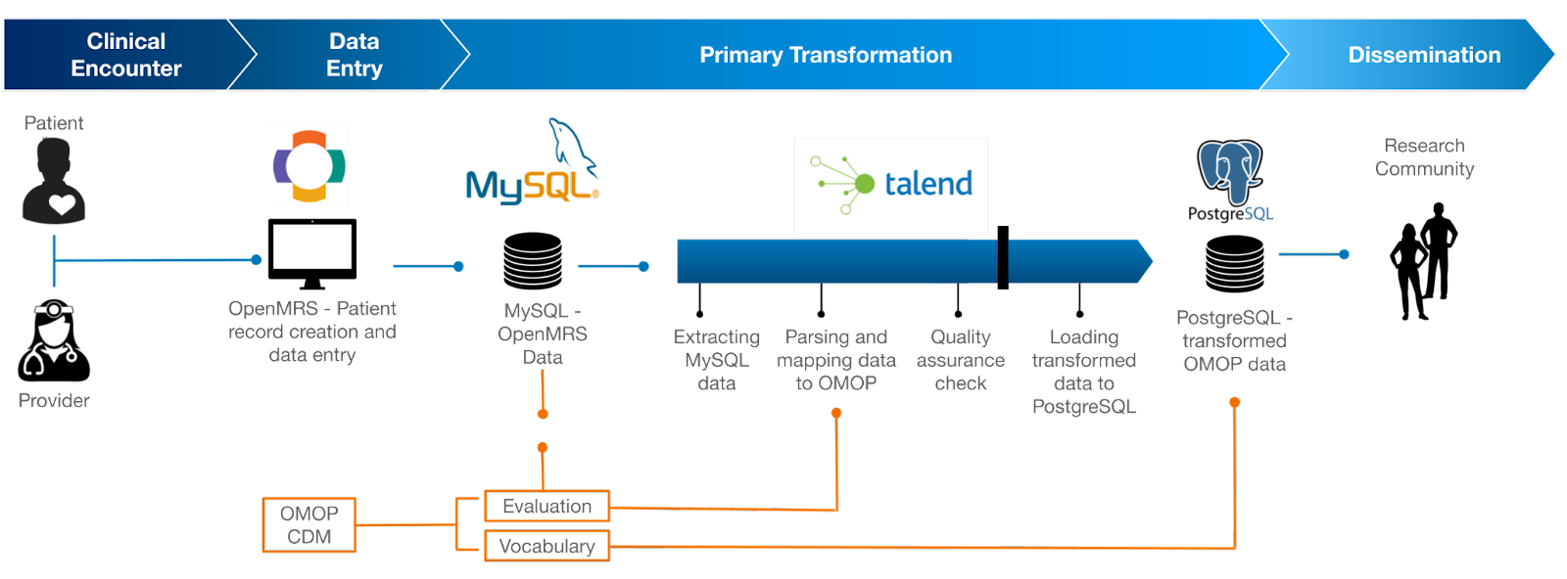
Overview

Slide 10
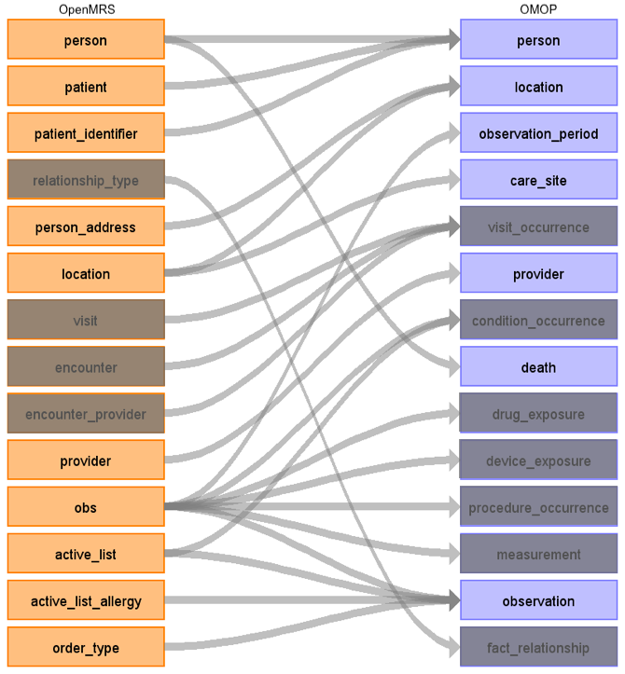
Results - Domains

Slide 11
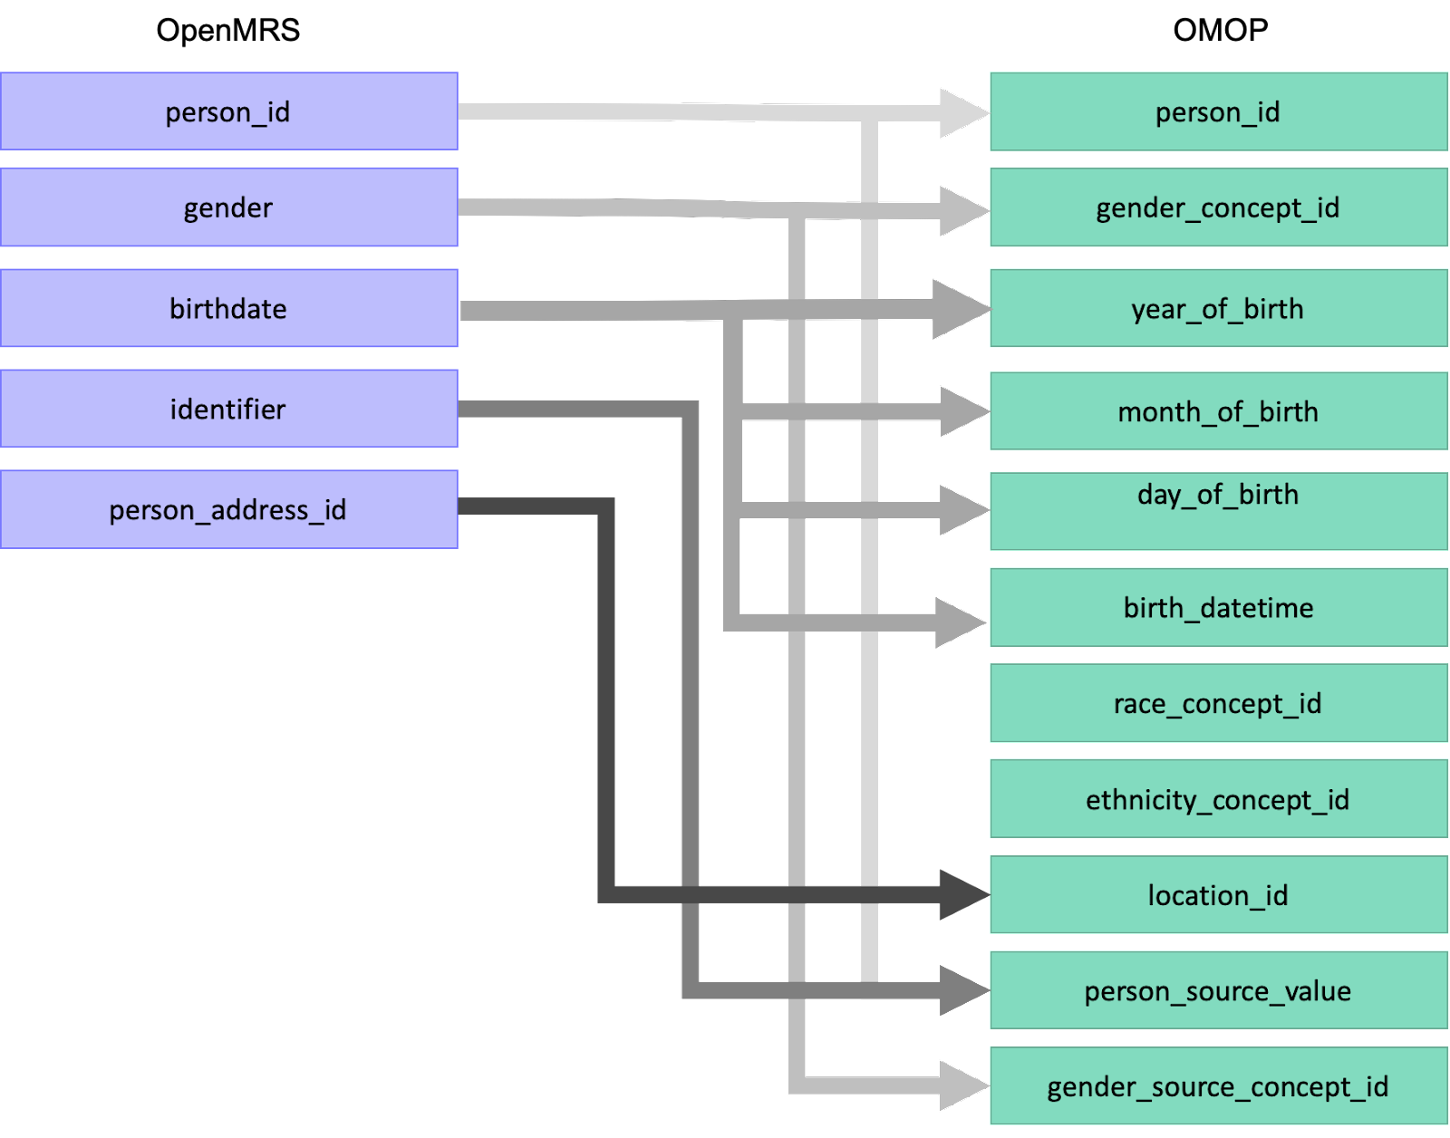
Results - Mapping (person table)

Slide 12
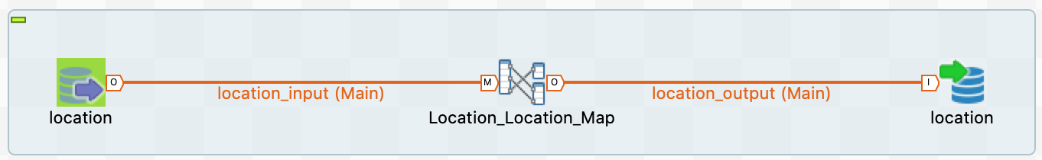
Results - ETL

Slide 13
Results
Technical assets developed
Complete Talend project with 7 ETL jobs
care_site, location, observation_period, observation, person_death, person, and provider
Extensive documentation in public open-source GitHub Repository
Performance metrics
9,932 observation records transformed
101 valid person_ids
≤2 tDBInputs, 1 tMap, and 1 tDBOutput
15 minutes

Slide 14
Limitations
Not all domains were mapped
Specific technical environment
Performance can be improved
Notes:
Use our conclusion, make bullet points

Slide 15
Conclusion
Our ETL tool can transform OpenMRS data to OMOP and facilitate applications that leverage the powerful tools developed for OMOP.
This tool can be implemented free of charge with open source software available to all individuals.
Collaboration with the global community is needed for additional mappings.

Slide 16








Thank you!
Funding
This project was supported by an anonymous gift. Juan Espinoza’s time is supported in part by the following grants from the National Center for Advancing Translational Science (NCATS) of the U.S. National Institutes of Health.
UL1TR001855
UL1TR000130
Juan Espinoza, MD
Sab Sikder, BA
Armine Lulejian, EdD
Barry Levine, PhD
James Dickhoner, MD
Lynn Kysh, MLIS
Ernesto Rodriguez, BA
Avetis Developers
Notes:
JA AI health disclosure

